Slide 1
This slide deck is not a presentation. It’s to export diagrams and images in an image format for use in markdown files.

Slide 2
Instructions
Create the graphic on a blank slide
Select the slide
Click File -> Export
Name the file, select the directory to export it to
lesson_number order_brief description.png
Change the file format to PNG
Set the dimensions to 1800 x 1013

Slide 3




Slide 4
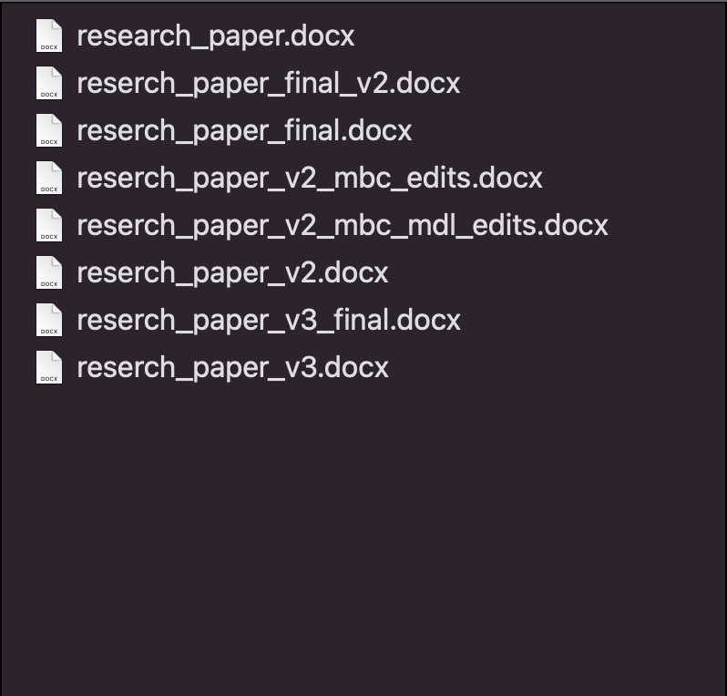

Slide 5
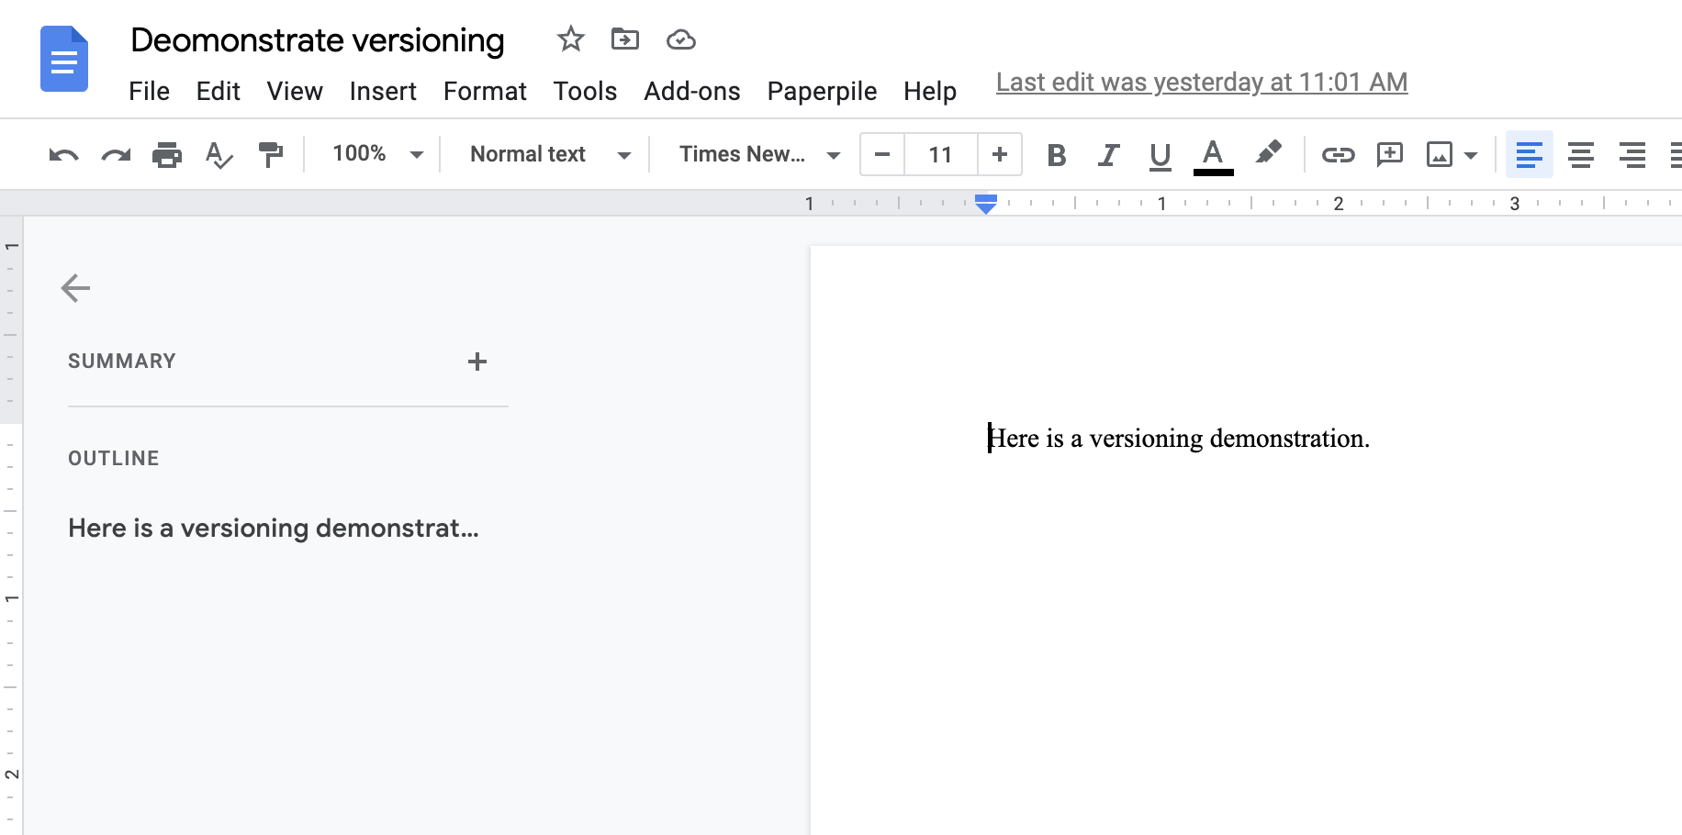

Slide 6
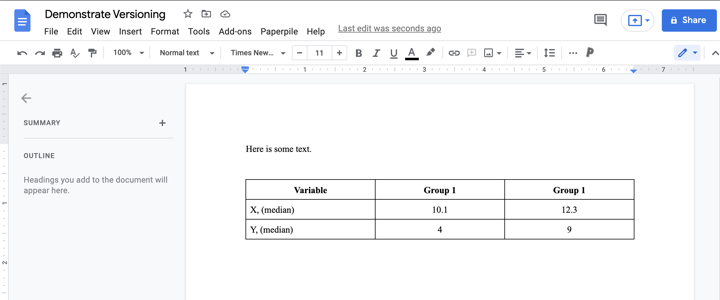

Slide 7
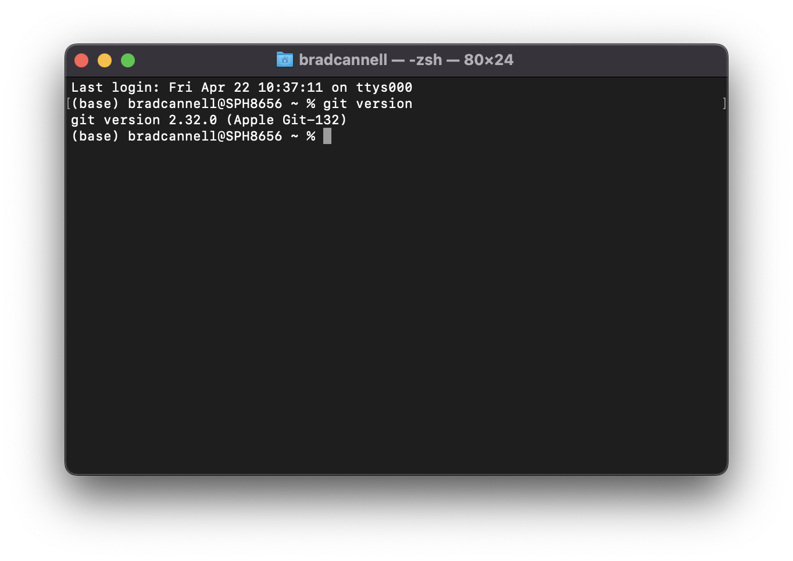

Slide 8


Slide 9


Slide 10


Slide 11


Slide 12
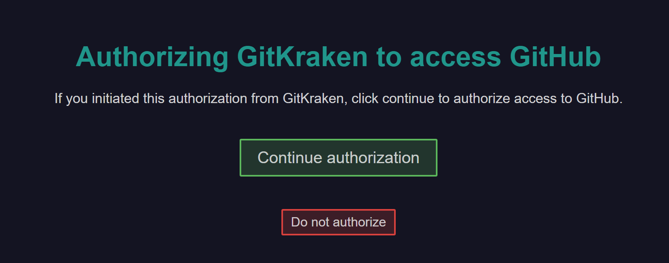

Slide 13


Slide 14
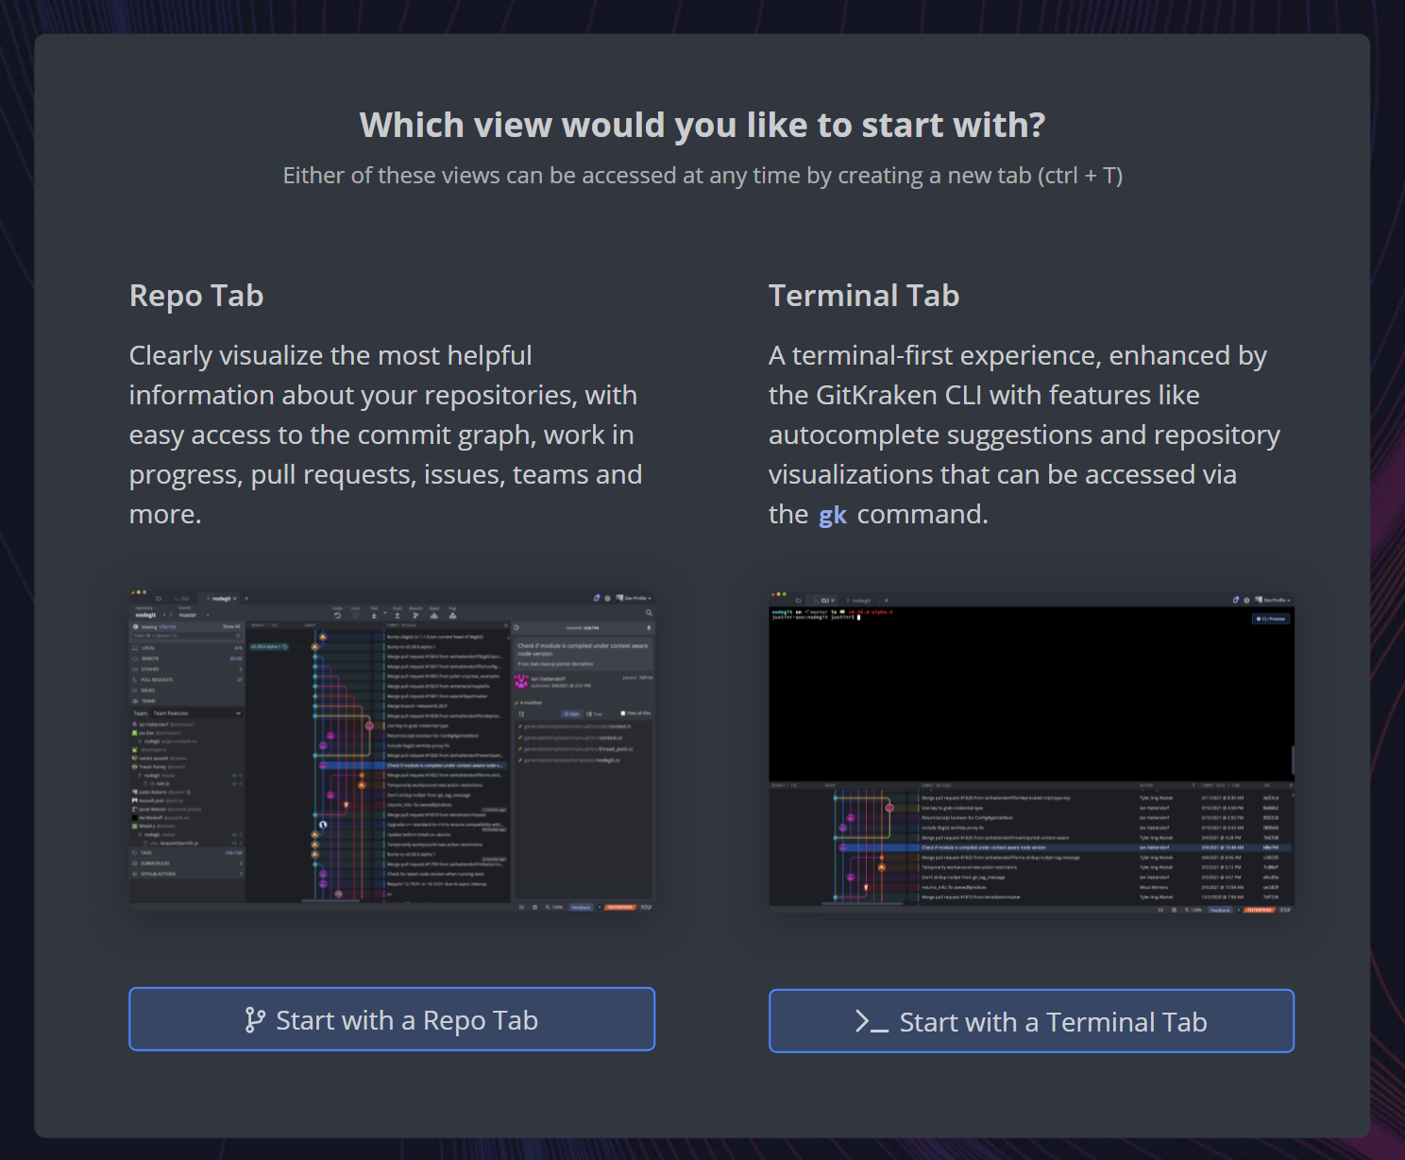

Slide 15




Notes:
What is a repository?

Slide 16
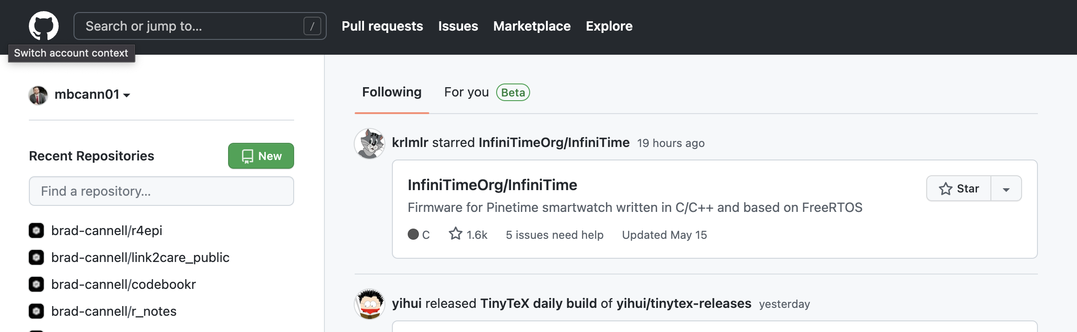

Slide 17
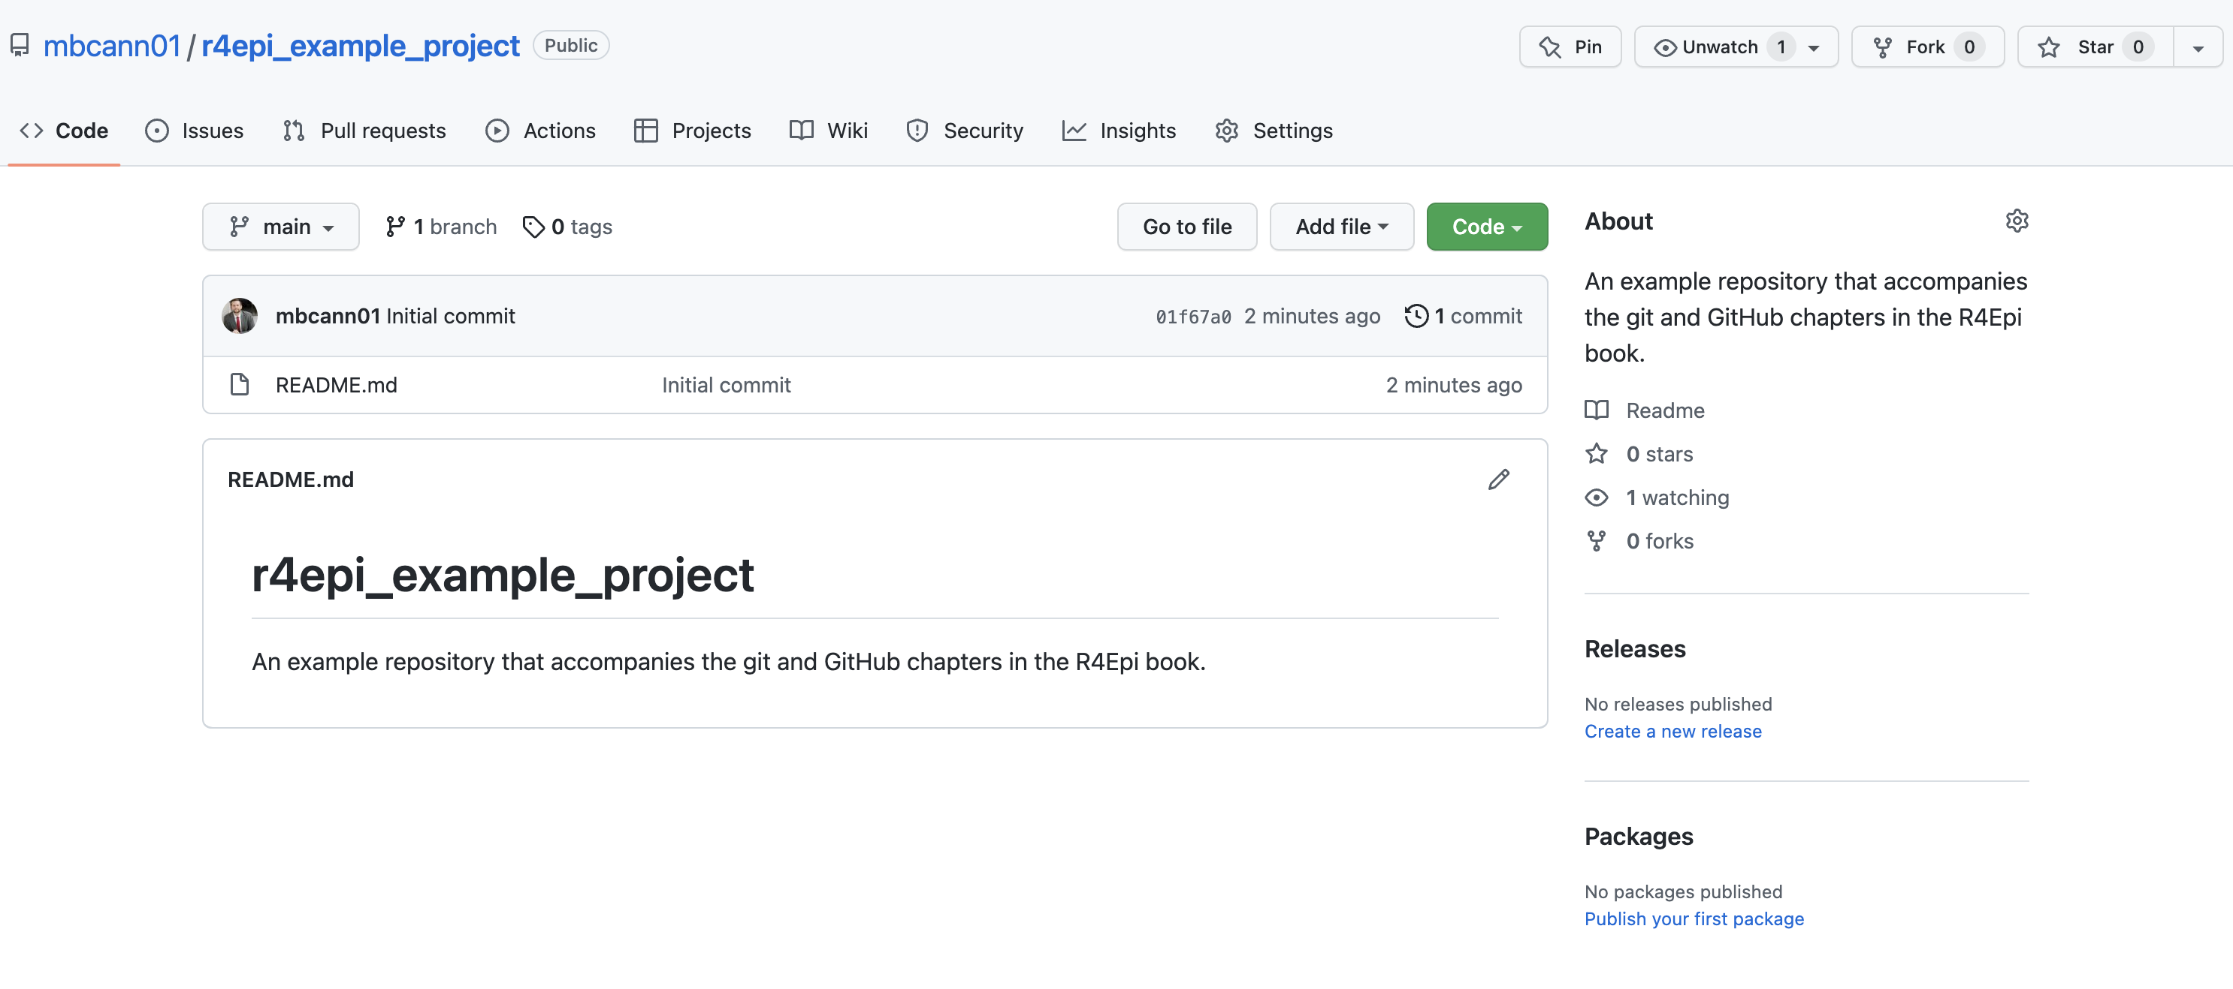

Slide 21
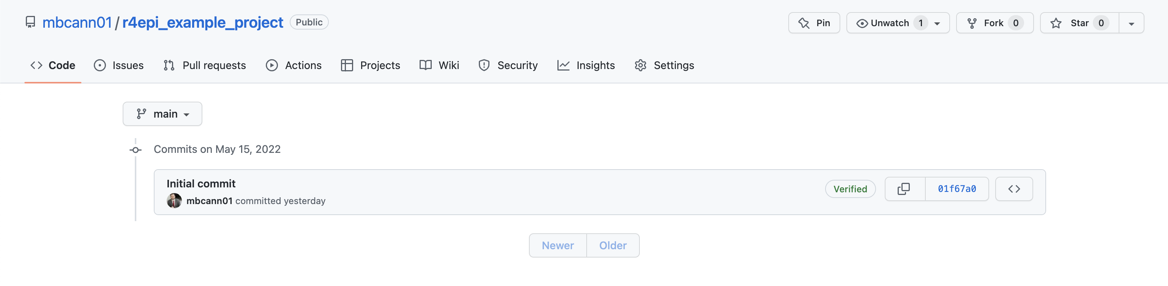

Slide 22
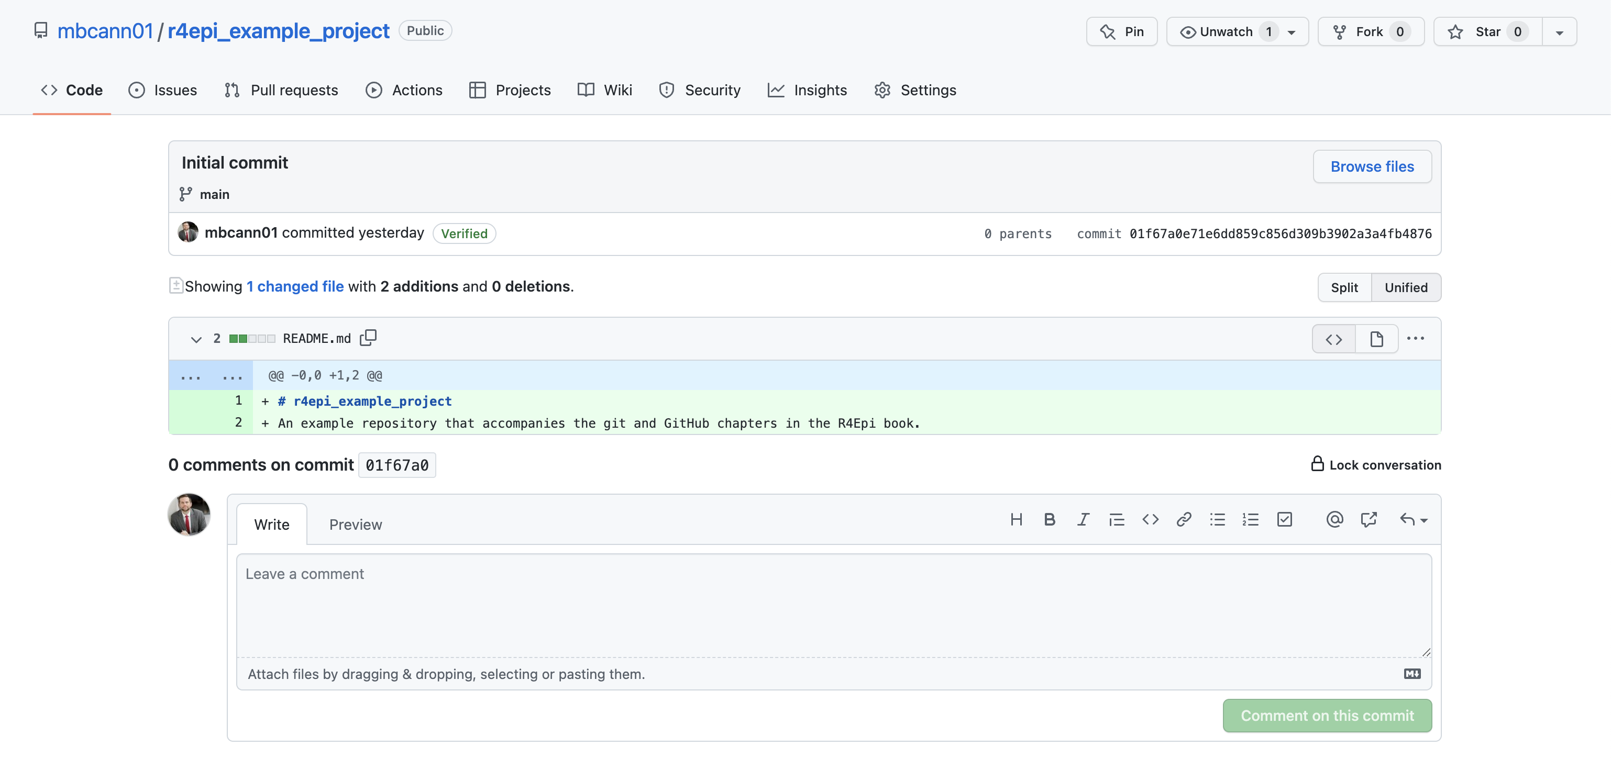

Slide 25
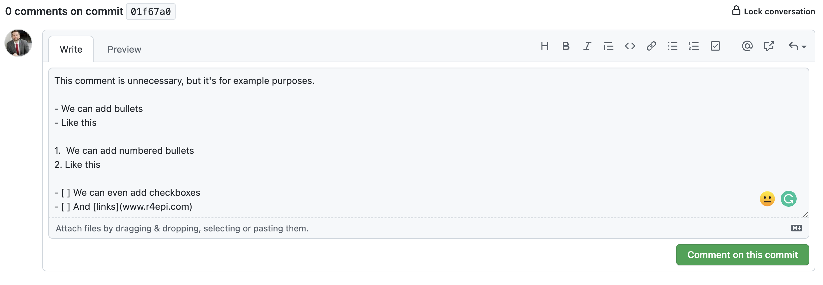

Slide 26



README.md

Slide 27
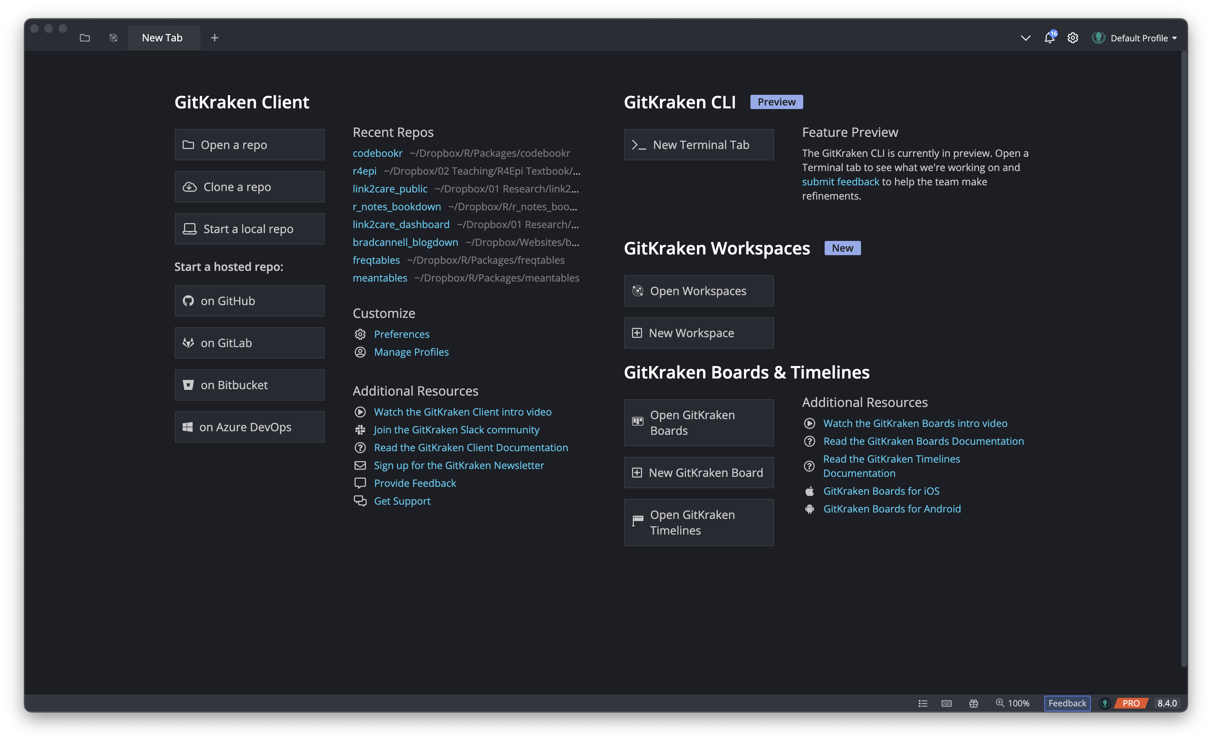

Slide 28
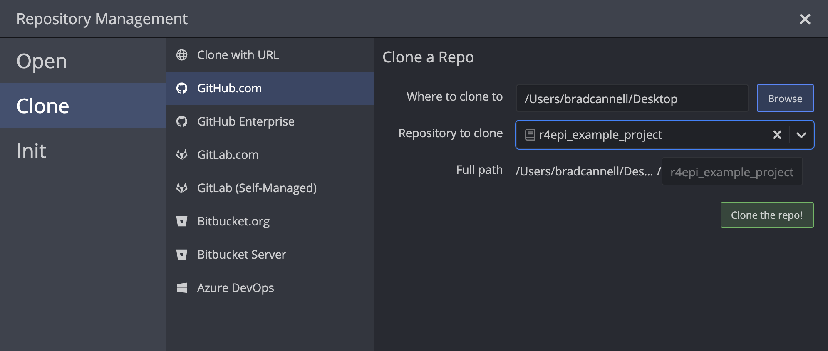
1
2
3

Slide 29

Remote Repository (“repo”)
README.md
Cloned
Local Repository (“repo”)
README.md

Slide 30
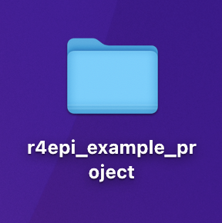

Slide 31
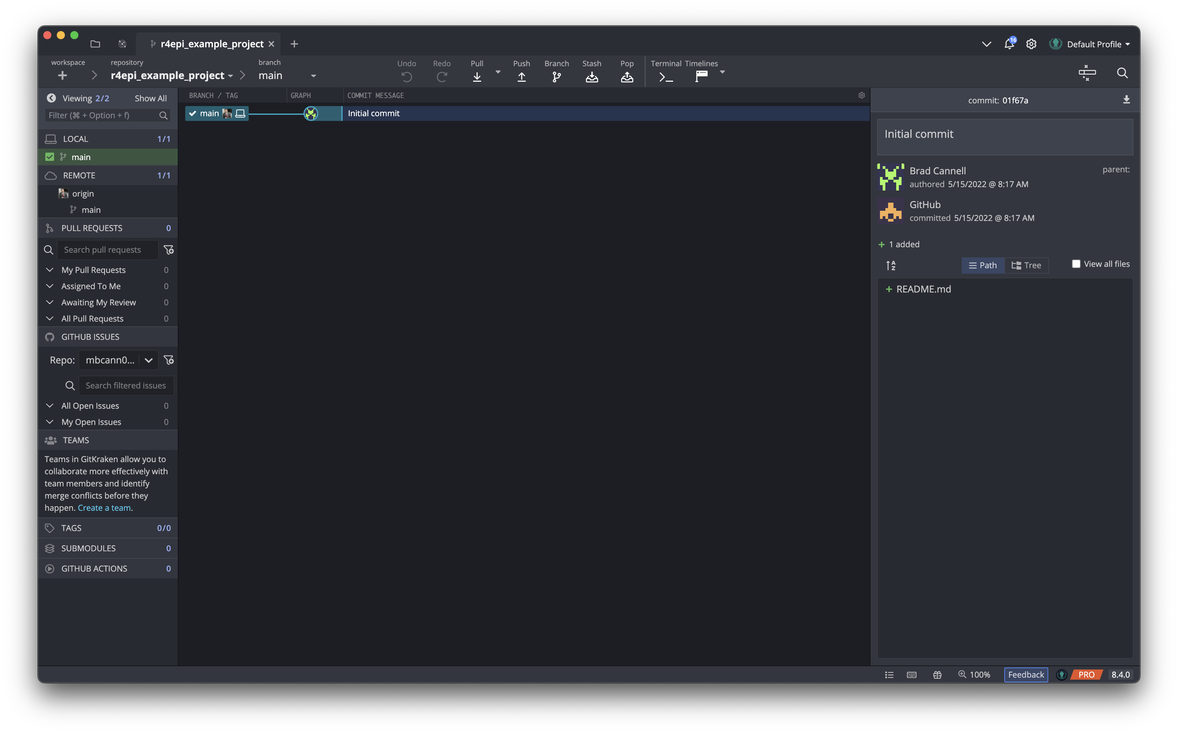

Slide 32
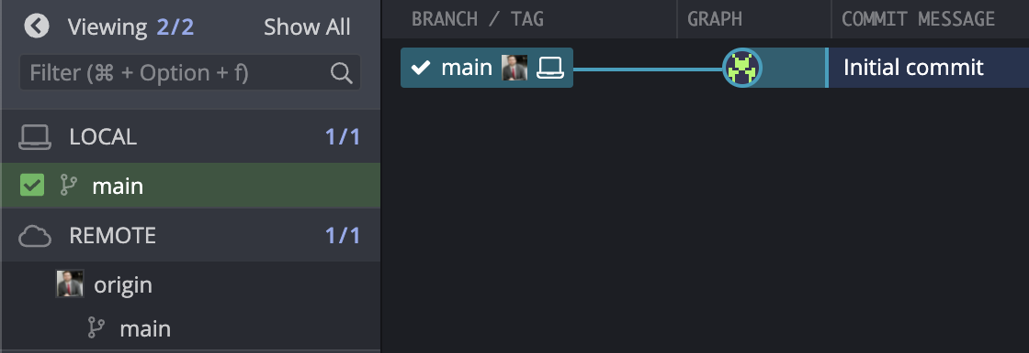

Slide 34
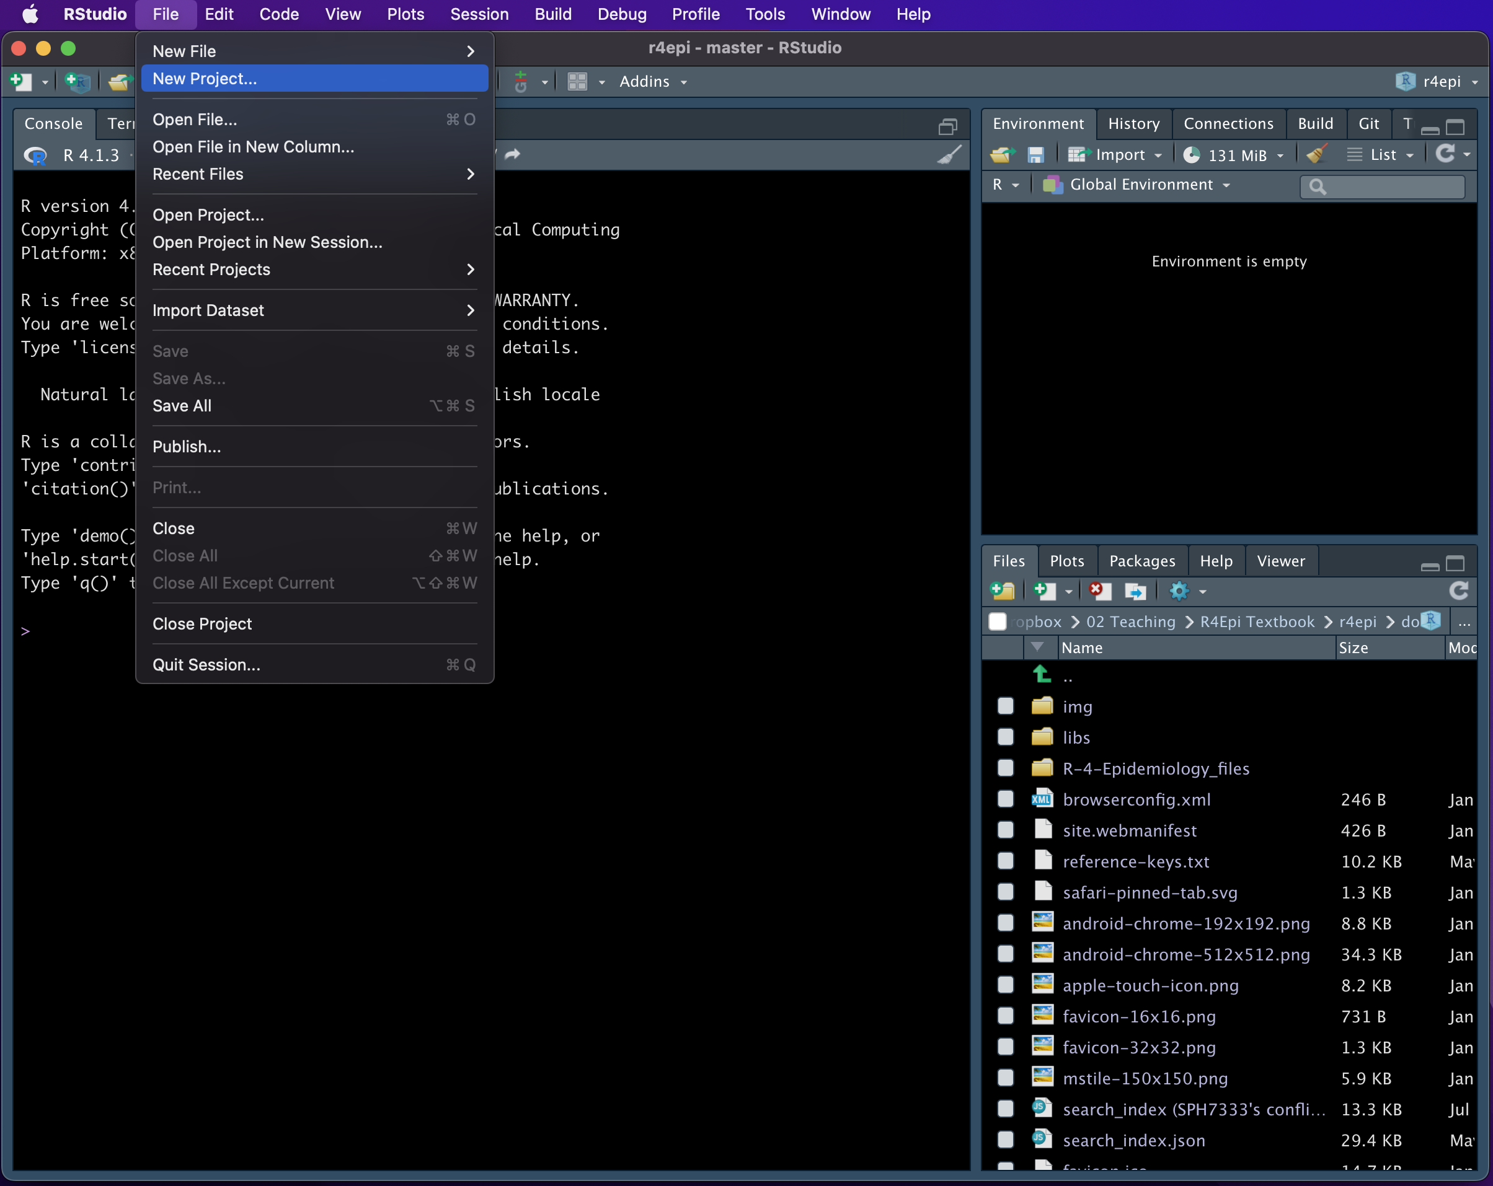

Slide 35
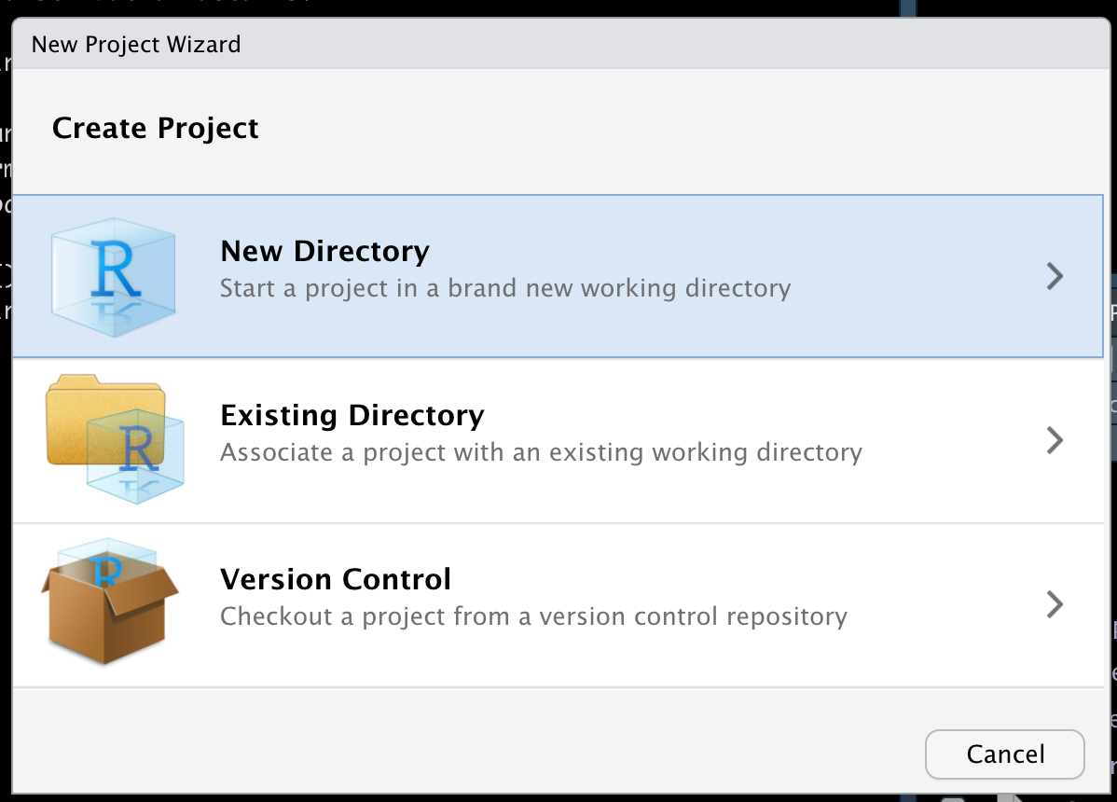

Slide 36
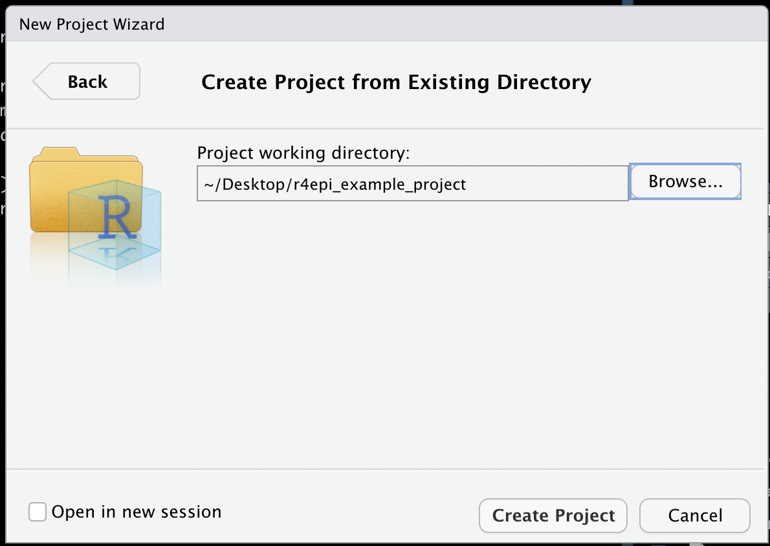

Slide 37
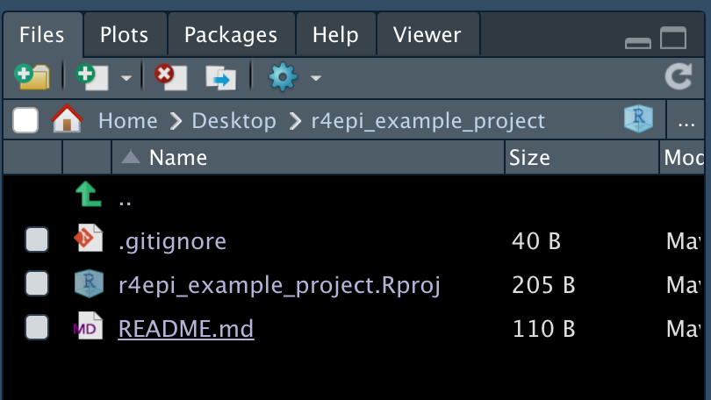

Slide 38
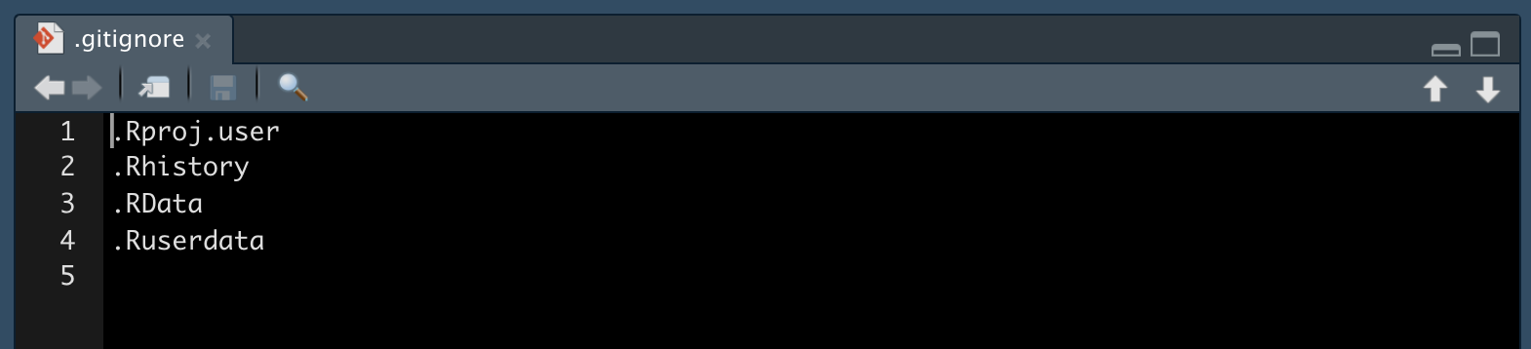

Slide 39


Slide 42
References
R4Epi
R Notes
Git book
Happy Git for the useR
Jenny’s Git paper on Paperpile

